Slide 1
18 – 20 September 2014
Transformational
Business
Mats Tunehag

Slide 2
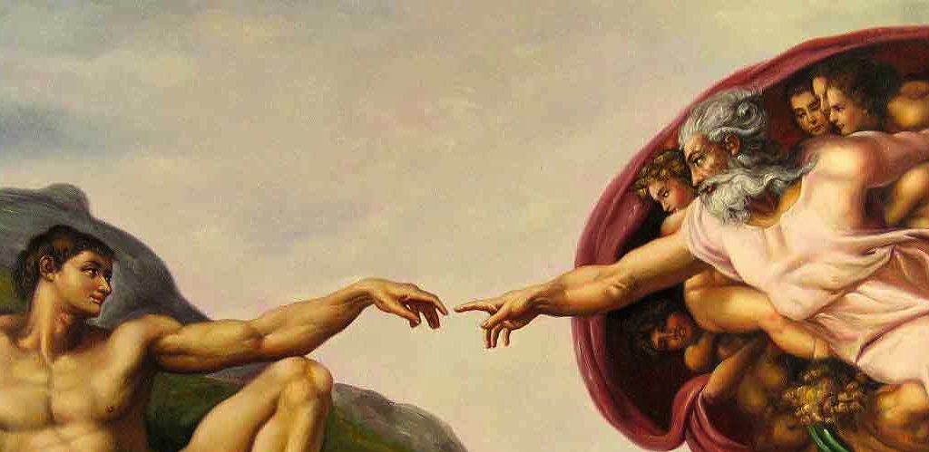

Slide 3
Wealth creation is a godly talent
“Remember the LORD your God, for it is he who gives you the ability to produce wealth.” (Deut 8:18)

Slide 4
Engage in economic development
“This is what the Lord Almighty says to all those I carried into exile from Jerusalem to Babylon: Build houses and settle down; plant gardens and eat what they produce. Also, seek the peace and prosperity of the city.”
Jeremiah chapter 29

Slide 5
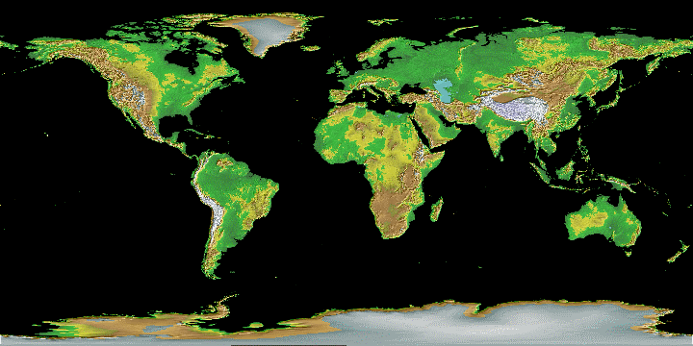
A growing global movement asking: How can we shape business for God and the common good?

Slide 6
We are not just in business but working on the business, aiming at a holistic impact through multiple bottomlines, recognizing various stakeholders.

Slide 7
How can we shape businesses to…
serve people,
align with God’s purposes,
be good stewards of the planet,
and make a profit
QUADRUPLE BOTTOMLINE
Among all peoples

Slide 8
Business as…
Human Dignity
Justice
True Religion
Shalom
Great Commission

Slide 11
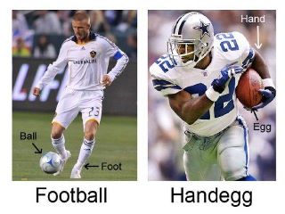
What shall we call it?

Slide 12
Kärt barn har många namn
Translation: A beloved child has many names.
Meaning: Someone or something which is popular is often referred to by many different nicknames, labels.
CSR: 2008 study, 37 definitions, but strong congruence in understanding and praxis of corporate responsibility

Slide 13
Other beloved children
SECULAR ARENA
Market-based solutions to poverty
Social enterprise
Creative capitalism
Impact enterprise
Conscious capitalism
Inclusive business
CHURCH ARENA
Business as Mission
Missional Business
Great Commission Companies
Business for Transformation
Transformational Business

Slide 14
Common denominators in our context
Business
Kingdom of God
Holistic Transformation
Global
God Glorified

Slide 15
Called to business
“A cobbler, a smith, a farmer, each has the work and the office of his trade, and they are all alike consecrated priests and bishops, and every one by means of his own work or office must benefit and serve every other, that in this way many kinds of work may be done for the bodily and spiritual welfare of the community.”
Martin Luther

Slide 16
Business in community, for community
“The purpose of a business firm is not simply to make a profit, but is to be found in its very existence as a community of persons who in various ways are endeavoring to satisfy their basic needs, and who form a particular group at the service of the whole of society.“
Pope John Paul II, Centesimus annus 1991

Slide 17
Doing business in community for community
Quakers UK & beyond, 1600 →
Motto: Spiritual & Solvent
Early 1800s: Only 0.2 % of population, but 4000 Quaker families ran 74 banks and over 200 companies
Anyone wanting to set up in business was “especially required to seek the consent of the meeting” and continue to subject their business practices to the scrutiny of their peers on an ongoing basis
This was discussed in their Christian fellowship halls

Slide 18
Computer pioneer Dave Packard:
”Many people assume, wrongly, that a company exists simply to make money. …
People get together and exist as a company so that they are able to accomplish something collectively that they could not accomplish separately - they make a contribution to society.”

Slide 19
Love God - Love Stakeholders
“Any business that says it loves God but does not love its stakeholders is a liar.”
Loving stakeholders (including owners, investors, employees, suppliers, customers, the physical environment, etc) means working for their good.
Need to plan, operate and evaluate based on holististic transformational metrics
(paraphrase 1 John 4:20)

Slide 20
Sample of metrics questions
Are we the business God has called us to be
Are we operating in a way that reflects God’s love for his creation, and that will help transform society?
Do we reflect the values of Kingdom of God when meeting customers
Does our company respect laws and customs and operate on Christian values?

Slide 21
More sample of metrics questions
Do our products and services give healthy benefits to the community?
In hiring, training, evaluating, rewarding, and dismissing the employees, does the whole process reflect well the values of the Kingdom of God?
Are the values of the Kingdom of God manifest in relationships with suppliers, distributors or contractors?

Slide 22
BAM Think Tank Reports
Nr 12. Measuring the Impact and Performance of BAM Businesses
www.BAMthinktank.org

Slide 23
What are we?
Christians doing good and ethical business only; social enterprise, CSR
or
Do we also have a mission to glorify God and make Jesus known?

Slide 24
Holistic Transformation
Takes time
Robert Woodberry and 50 research assistants
14 year long research project
Christian mission on many continents and long term impact

Slide 25
Observations / Conclusions
Correlation between Jesus centered conversionary missionaries
and
democratic development, better health, lower corruption, greater literacy, higher educational attainment and stronger civil society, et cetera.

Slide 26
Implications
There is not one-size-fits-all approach or just one way of being a follower of Jesus in the marketplace.
We need to be tactful and also mindful of culture and security related issues.
But at the same time we should learn from those who have gone before us: Jesus centered missionaries were instrumental in bringing about holistic transformation.

Slide 27
Global Issues - Business Solutions
Poverty (BAM Think Tank Report # 2)
Corruption
Creation care
Unreached peoples (BAM Think Tank Report # 10)
Human trafficking (BAM Think Tank Report # 4)
Unemployment
Etc…

Slide 28
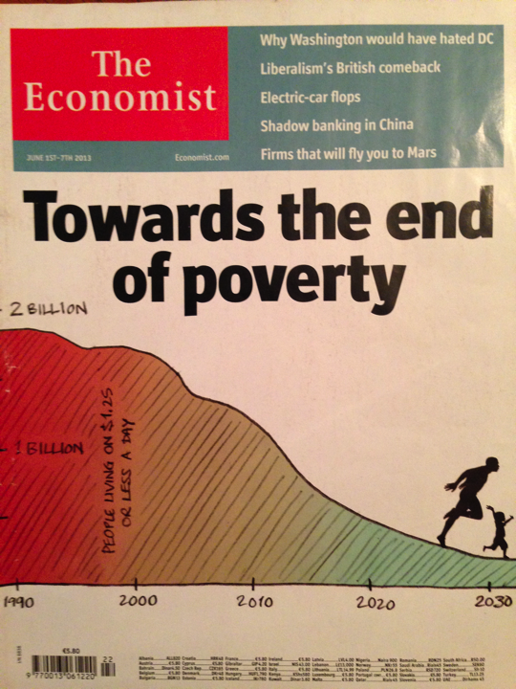
Good news

Slide 29
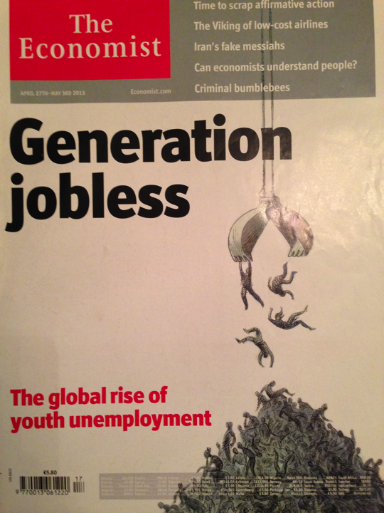
Bad news

Slide 30
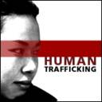
Transformational Business &

Slide 32
www.BAMthinktank.org
1. Partnerships: Maximizing effectiveness in partnerships between business and nonprofits engaging in anti-trafficking works.
2. Employability: Identifying challenges, strategies and resources for businesses who employ persons from a background of exploitation and abuse.
3. Freedom business models: Creating paths to sustainability and growth for freedom businesses.

Slide 33
How to scale business solutions for greater impact

Slide 34
Problem & Questions
Big problems, global issues, like poverty
Business solutions too small or fragmented
Limited impact
How scale, create critical mass, for great impact?
What are the barriers, and how can they be overcome?

Slide 35
Enter the Industry Facilitator
Industry facilitators act to resolve scaling barriers, at the levels of both the enterprise and its wider business ecosystem, to the benefit of many firms, not just one.
They may provide financial resources, build capacity, generate knowledge, train producers, broker partnerships, advocate with public policymakers,...
Different organizations can step into such roles, like foundations, aid donors, mission-driven intermediaries, development agencies, investors, industry association…

Slide 36
5+ ways going forward
Rediscover theology of work and business
Affirm, equip and deploy people who are called to business
Shape business for God and common good, recognizing various stakeholders and aim at holistic impact through multiple bottom lines
Pursue business solutions to global issues
Facilitate transformational business eco-system for greater impact

Slide 37
MatsTunehag.com
bamthinktank.org
europeanfreedomnetwork.org
businessasmission.com
vatican.va 1. CENTESIMUS ANNUS
2. LABOREM EXERCENS

Slide 38
How can we…
Rediscover theology of work and business?
Affirm, equip and deploy people who are called to business?
Shape business for God and common good, recognizing various stakeholders and aim at holistic impact through multiple bottom lines?
Pursue business solutions to global issues?
Facilitate communication and cooperation in a greater transformational business eco-system for greater impact?

