Slide 1
18 – 20 September 2014
Social Innovation
Patrick McDonald with
Sanjay Mahtani
Notes:
Intro
Viva
Gap year
Kindergardens
PPP – Casa Viva
OBF
Sn Asc of LCWE / WEA / AD2000
World full of trouble
World of beauty and opportunity
Creative God: Gives good people opportunity and ideas
3 spheres
NGO
Gov
Biz
These entrepreneurs often struggle as they lack
Confidence
Experience
Contacts
Credibility
Coherence
Sequense
Stages of growth
Team
Capital
That’s what we seek to provide
Expertise
Capital
Expertise
3ds
Capital
Slider
Market place

Slide 2
Who are we?

Slide 3
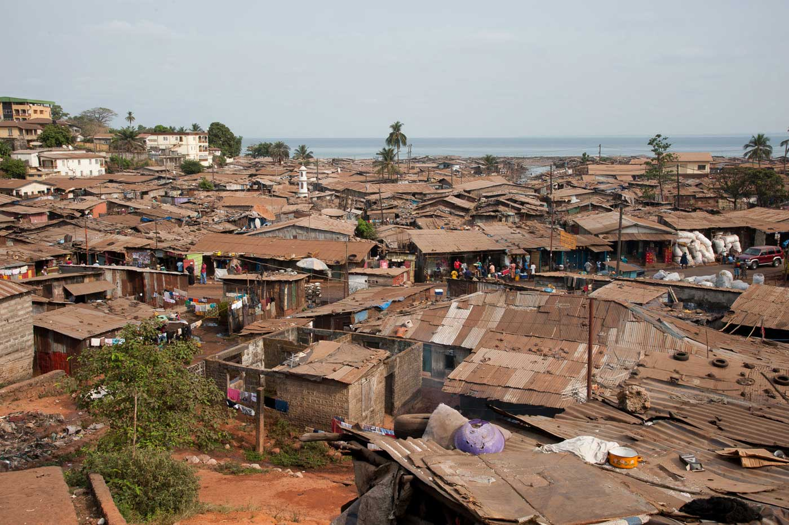
...a troubled world

Slide 4
...an wonderful world

Slide 5
...ideas versus opportunity

Slide 6
...opportunities originate from
State
Business
Civil Society

Slide 7
...it all comes down to the entrepreneur

Slide 8
...what does entrepreneur need?
Team
Confidence
Right Sequence
Stages of growth
Credibility
Experience
Capital
Contacts
Coherence

Slide 9
...that’s what we seek to provide
Expertise
Capital

Slide 10
...Expertise
Discovery
Design
Delivery

Slide 11
...Capital
Philanthropic
Social Capital
Commercial
Higher Missional Impact
Higher Monetary Returns

Slide 12
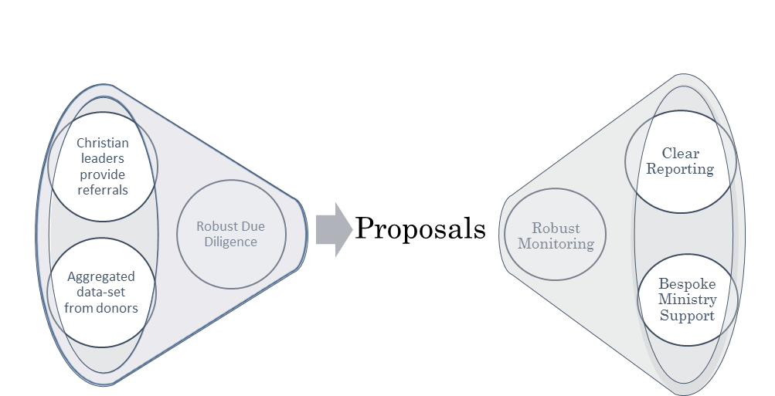
...something we are building

Slide 13
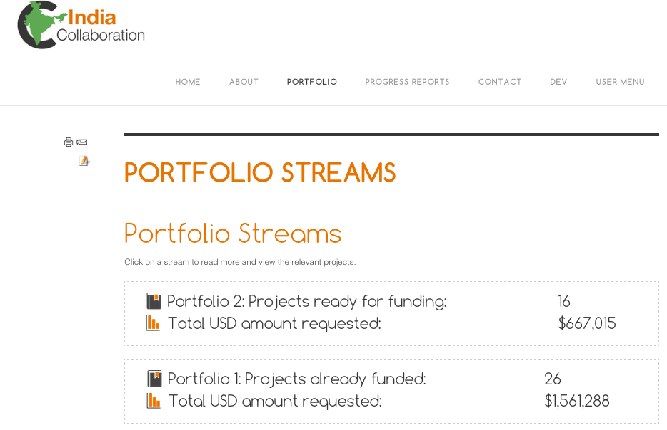
…market place in action

Slide 14
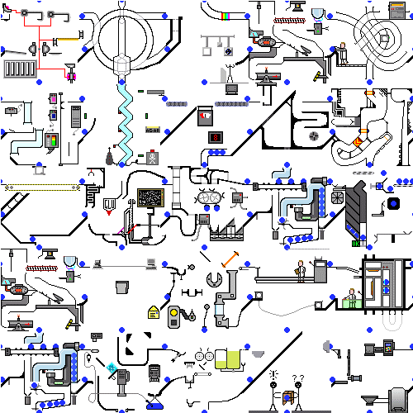

Slide 15
…so what do we want from you?
Have you got a world changing solution?
Do you want to help us support world changing entrepreneurs?
Do you have money to deploy into world changing solutions - either as donations or investments?
Do you want to help us build a platform where entrepreneurs can find the support they need?

Slide 16
Contact us:
Patrick.McDonald@OxfordVentures.co.uk
Sanjay.Mahtani@OxfordVentures.co.uk

