Slide 1
ADDRESSING GLOBAL ECONOMIC PROBLEMS: Tinkering with the Margins vs Changing the System
Prabhu Guptara
prabhusguptara@gmail.com

Slide 2
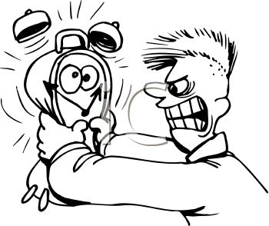
PLEASE NOTE
Limitations of time inevitably mean exaggerations and distortions!
Notes:
I must point out that I have a large topic and a tiny amount of time, which will have certain consequences, meaning some exaggerations and distortions!

Slide 3
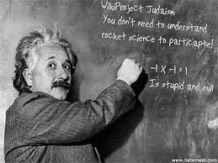
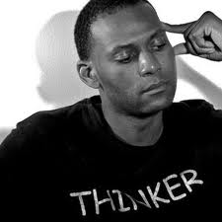
Please note
The intention is to provoke you to think!!!

Slide 4
Please note
I am a Hindu follower of Jesus the Lord
He was anti-religious, so I am anti-religious too
He was constantly in touch with God; I try to be in a position where God can at least sometimes get through to me
Most Christianity seems to be a systematic attempt to distort and subvert Jesus the Lord’s teachings and person.

Slide 5
Structure of my presentation
A. Some preliminary comments
B. Reflections on our current global crisis
C. What are some key features of our “Global System”?
D. The 5 Paradigms for Understanding Systems & System-Change
E. Some System-Change Initiatives
Notes:
You can get much more material on the content of this lecture, if you like, by looking for my articles and book chapters on the Internet.

Slide 6
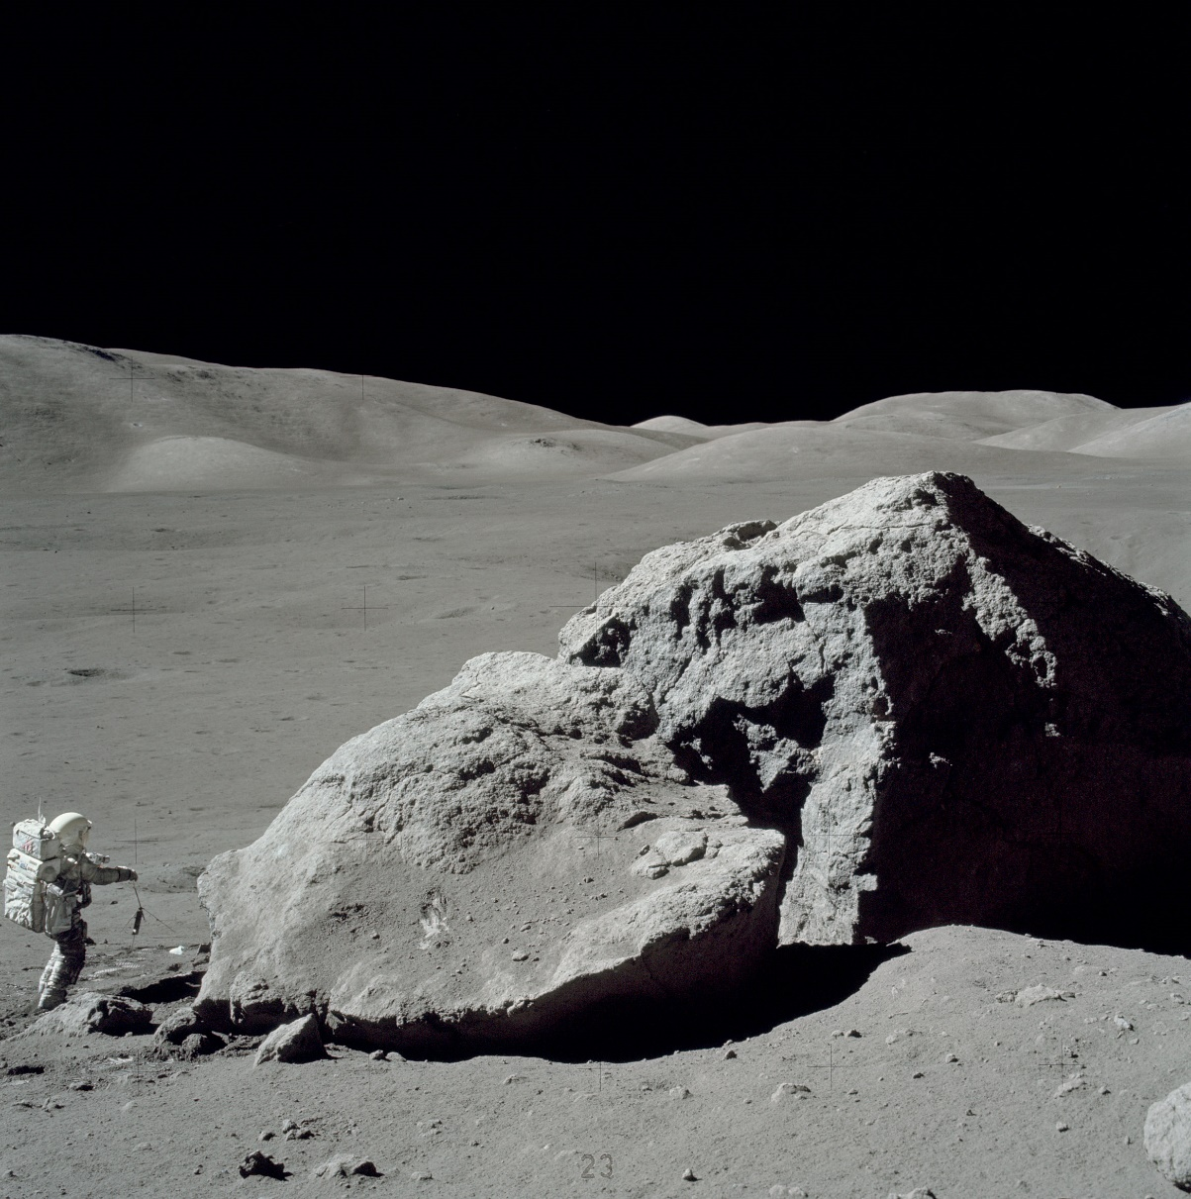
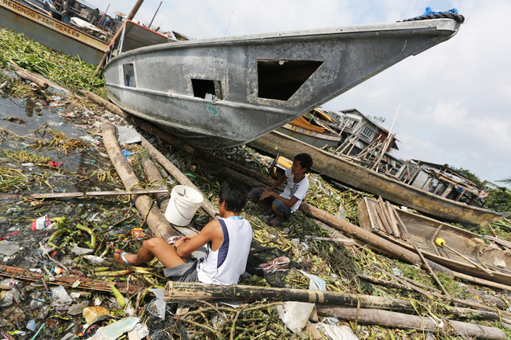
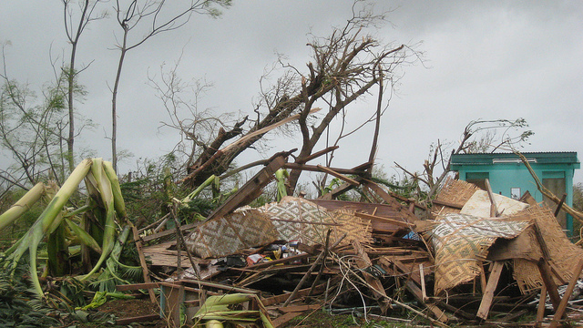
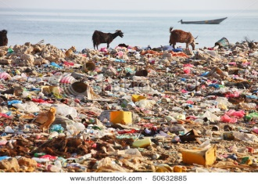

Slide 7
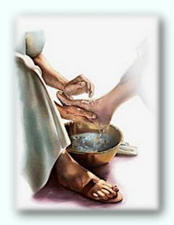
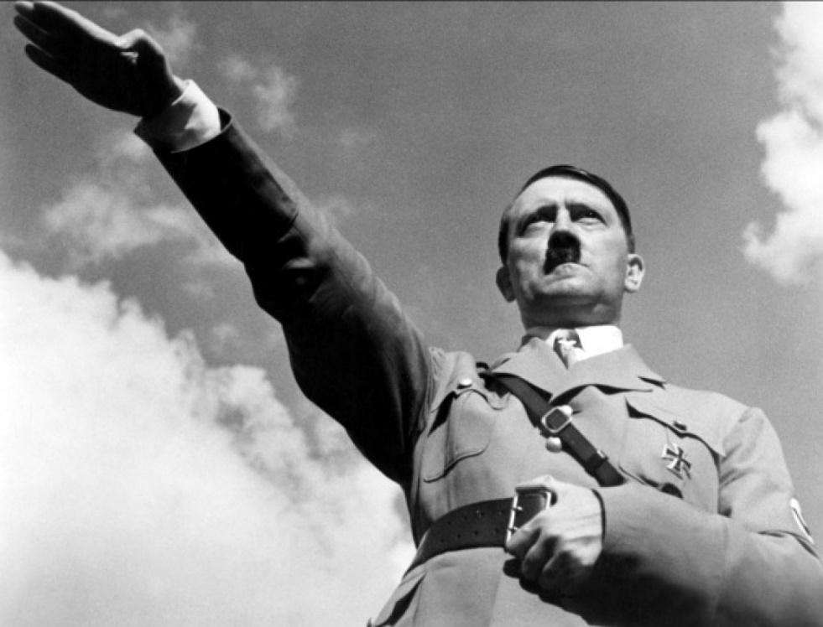
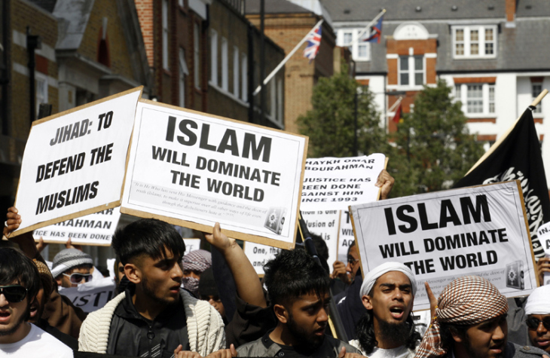

Slide 8
The four most important questions
What is the purpose for which my life was created by God?
What sort of character ought I to develop – and to encourage in others?
What is a good life-style?
What is a good society?

Slide 9
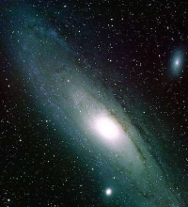
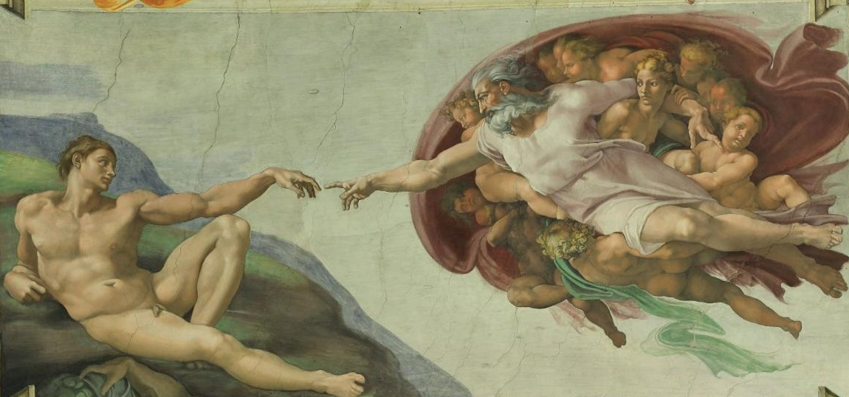
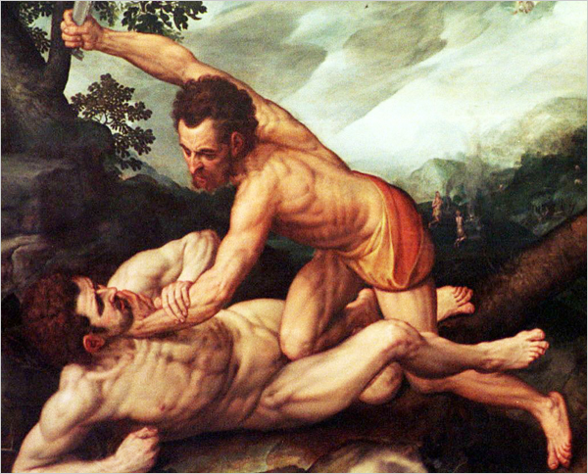
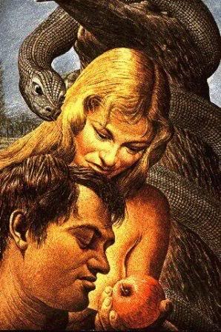

Slide 10
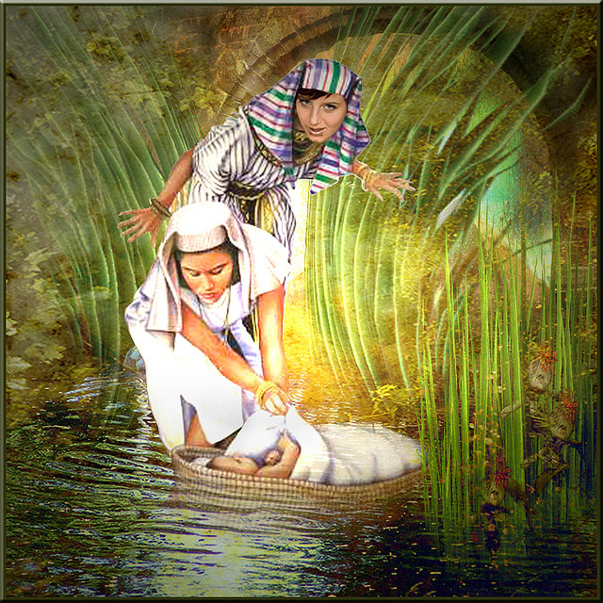
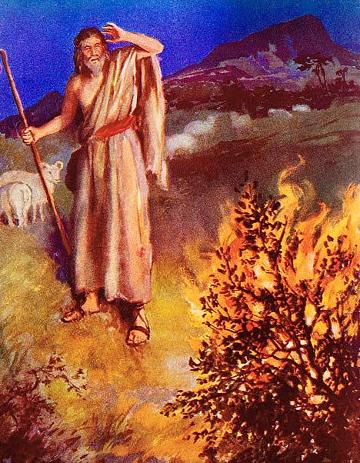
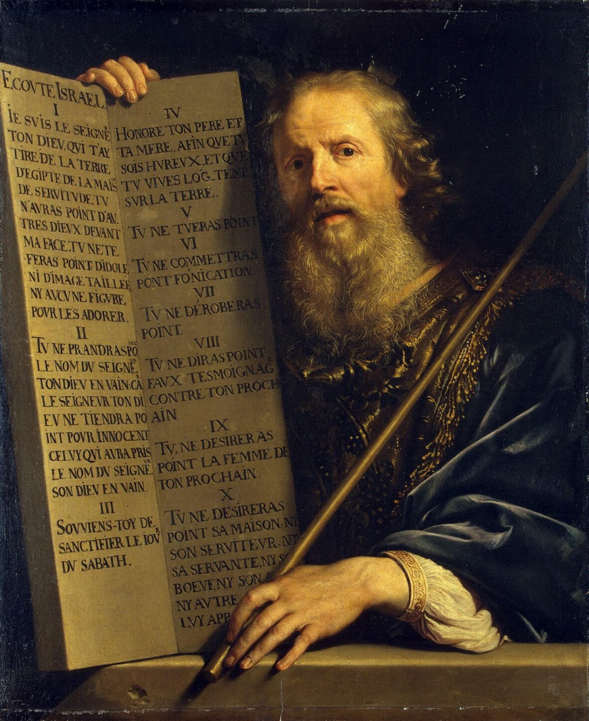
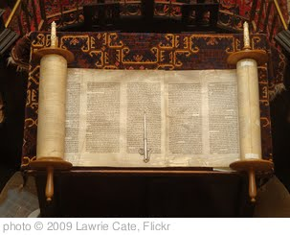
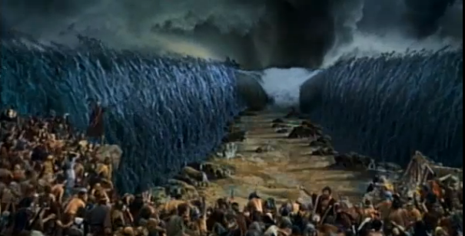
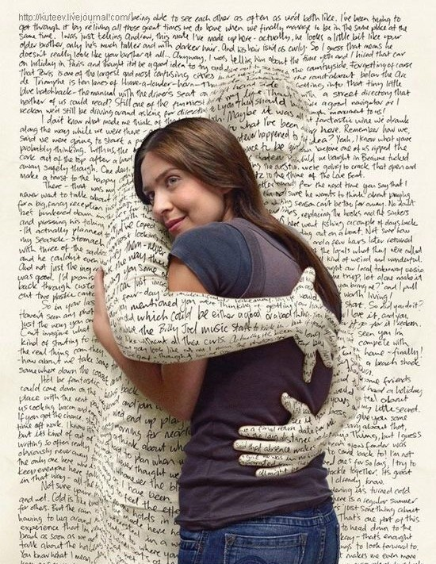

Slide 12
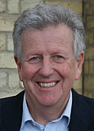
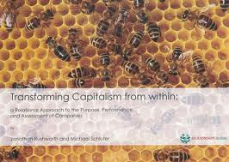
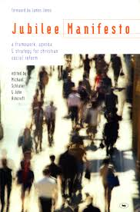
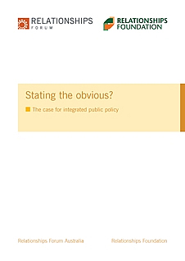

Slide 13
Structure of my presentation
A. Some preliminary comments √
B. Reflections on our current global crisis
C. What are some key features of our “Global System”?
D. The 5 Paradigms for Understanding Systems & System-Change
E. Some System-Change Initiatives
Notes:
You can get much more material on the content of this lecture, if you like, by looking for my articles and book chapters on the Internet.

Slide 14
Our current global economic crisis is due to:
Excessive liquidity
Excessive credit
Excessive leverage
Excessive short-termism
Excessive speed of movement in the world’s money
Excessive selfishness
Excessive avoidance of law

Slide 15
The dimensions of our current economic crisis
Volatility
Vulnerability
Negative or marginal real interest rates
Continuing growth of the financial economy though the real economy languishes
Reduction of real wages of workers in the West (&, now, also in the rest of the world)
Massive increase in the gap between the poor and the rich
Massive stress upon the poor and unemployed
Massive reduction of government finances (taxes), making it politically difficult to provide hard as well as soft infrastructure – except in China & a few other countries
Pressure on philanthropy & civil society (reduced supply, hugely increased demand).

Slide 16
The challenges ahead
Global financial stability
The environmental crisis
China
India
Russia and the Middle East
Other “emerging markets”
The USA’s continuing spiritual and moral decline with consequent social, political and economic decline
The limits of Europeanisation.

Slide 17
Structure of my presentation
A. Some preliminary comments √
B. Reflections on our current global crisis √
C. What are some key features of our “Global System”?
D. The 5 Paradigms for Viewing Systems & System-Change
E. Some System-Change Initiatives
Notes:
You can get much more material on the content of this lecture, if you like, by looking for my articles and book chapters on the Internet.

Slide 18
Some features of our global financial system
Worldwide framework of bilateral and multilateral agreements, intergovernmental organisations, etc., without which international investment and trade would be difficult as financial capital would not flow so easily across countries
Even WITHIN countries, central banks and government largely influence: money supply and interest rates, as well as transparency and regulation (which influence trust in potential business partners)
Fiat money, presence of usury and therefore of interest rates, accounting systems that exclude “externalities”, GDP calculations that exclude other key realities of human life and essentials for human flourishing, obsession with growth.

Slide 19
Structure of my presentation
A. Some preliminary comments √
B. Reflections on our current global crisis √
C. What are some key features of our “Global System”? √
D. The 5 Paradigms for Viewing Systems & System-Change
E. Some System-Change Initiatives
Notes:
You can get much more material on the content of this lecture, if you like, by looking for my articles and book chapters on the Internet.

Slide 20
At the most basic level, there are only five worldviews:
Black
White
Yellow
Green and
Red
(The colours used are simply colours and do not signify anything beyond a help to memory)

Slide 21
BLACK
Dominant in all tribal societies
But also influences many «modern» societies even today – e.g.:
Arab culture
«green» movements ...
Notes:
I could give many other examples of non-tribal and even «modern» societies that are influenced by what I call the «BLACK» worldview

Slide 22
BLACK
Dominant in all tribal societies
But also influences many others even today – e.g. Arab culture, «environmental» movements
Fear of nature/ God/ the gods/ «fate»
Notes:
So what characterises what I call the «black» view of the world? Originally, it was a fear of nature and of the gods, or an acceptance of «fate» - though nowadays also a reaction against the kind of «progress» we have today, whose challenges and disadvantages are so clearly to be seen; a desire to, as they say, «live in harmony with nature» even though it is clear that nature is «red in tooth and claw» as Alfred Lord Tennyson put it.

Slide 23
BLACK
Dominant in all tribal societies
(But also influences many others even today – e.g. Arab culture)
Fear of or harmony with nature/ God/ the gods/ «fate»
May like to create system change!
But, given the world view, what chance of achieving system-change?
Notes:
I am being ironic of course: does «no progress» equal sustainability? NO, it simply means «no progress»

Slide 24
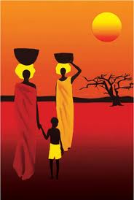
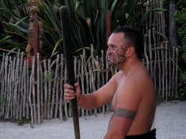
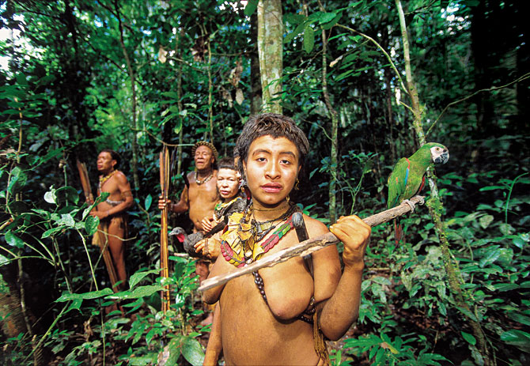
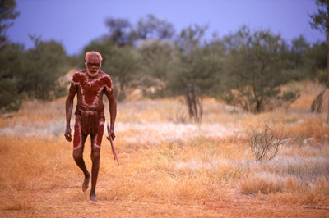
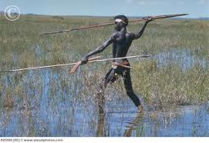
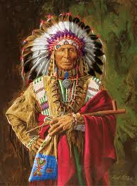
BLACK
Dominant in all tribal societies
(But also influences many others even today – e.g. Arab culture)
Fear of nature/ the gods/ «fate»
No progress!
Notes:
But this worldview is beloved of many romantics who would like us to worship «Gaia» or the earth mother, this worldview is idolised by many who would like us to be like the First People in Canada, or the native Indians in the USA or Brazil, or the Aborigines of Australia or the Maori of NZ.
As far as I can see, such attitudes are totally impractical. They are so «ideal» as to make any real implementation of these impossible.

Slide 25
At the most basic level, there are only five worldviews:
Black √
White
Yellow
Green
Red
(The colours used are simply colours and do not signify anything beyond a help to memory)

Slide 26
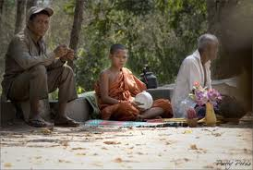
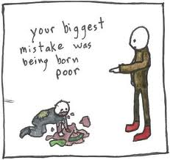
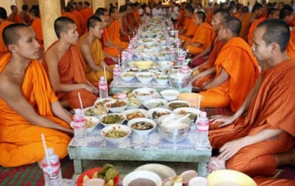
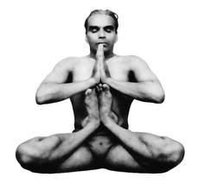
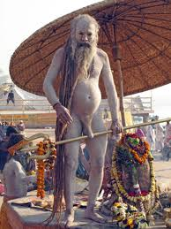
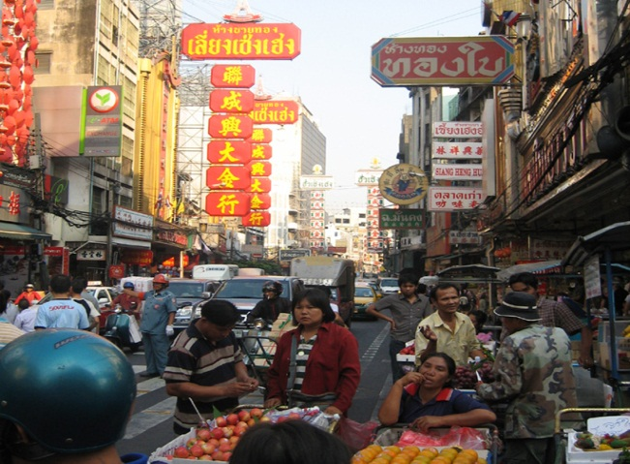
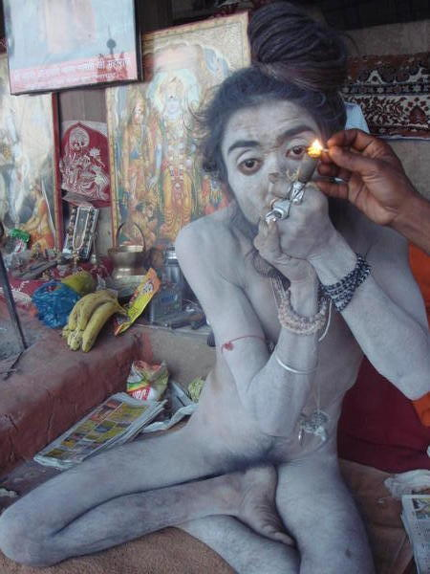
WHITE
Historically dominant in most non-tribal parts of the world; and influences many others today – e.g. Roman Catholic, Buddhist , Hindu...)
Notes:
Usually, this view of the world systematically ignores or even justifies the rule of an elite that is exploitative and oppressive

Slide 27
WHITE
Historically dominant in many parts of the world and influences many others even today – e.g. Buddhist and Hindu cultures
«the next world
is what matters;
this world is not important»
Notes:
In other words, this view is «so heavenly-minded as to be of no earthly use», beyond allowing or possibly justifying cultural oppression

Slide 28
WHITE
Dominant in many parts of the world historically
(But also influences many others even today – e.g. Buddhist and Hindu cultures)
«the next world is what matters; this world is not important»
No system-change!
Notes:
This does not mean that there were no specific achievements in «white» societies; just that the achievements were for specific and limited purposes, and did not result in much social transformation towards justice or opportunities for most ordinary people.

Slide 29
At the most basic level, there are only five worldviews:
Black √
White √
Yellow
Green
Red
(The colours used are simply colours and do not signify anything beyond a help to memory)

Slide 30
YELLOW
Dominant in most empires and dictatorships
From ancient times to the present
May or may not take a disproportionate share of the benefits of the system
Has to maintain and display sufficient power to avoid or counter any real or perceived threat to the top individual or group
Notes:
We could say that this is characteristic of all ancient empires and of most empires and dictatorships that are more recent: an individual, family, clique, tribe or group dominates.
Such a political system can be stable over a short or long time, depending on various factors.

Slide 31
YELLOW
Dominant in most empires and dictatorships, from ancient times to the present
«Don’t ask challenging questions; this arrangement is the only one that will work, and it is for everyone’s best»
Notes:
The official ideology cannot be challenged, for example, the ideology of Anglo-American financial capitalism must not be challenged if you want to succeed in it; however, ideologies that are perceived to be non-threatening (usually «White» ideologies) are tolerated or even encouraged

Slide 32
YELLOW
Dominant in most empires and dictatorships, from ancient times to the present
«Don’t ask challenging questions; this arrangement is the only one that will work, and it is for everyone’s best»
Progress ranges from huge to very little, depending on the nature and skill of the dictatorship or empire
Notes:
Usually there has to be at least enough stability and material progress to stave off threats to the ruling group.
The difficulty such systems face is in enabling transitions either from one generation to another, or to transitions within or from that system to another.

Slide 33
At the most basic level, there are only five worldviews:
Black √
White √
Yellow √
Green
Red
(The colours used are simply colours and do not signify anything beyond a help to memory)

Slide 34
GREEN
Dominant in Europe following the Protestant Reformation from the 16th century AD
But today influences most other parts of the world
Though the reformers may be Marxist, Hindu, Muslim or whatever, the inspiration, the objectives, and the standards by which reform has to be evaluated continue to be clearly from Jesus Christ
Notes:
including formally Communist and therefore atheistic China, majority Muslim countries such as Saudi Arabia, majority-Buddhist countries such as Sri Lanka and Thailand, and majority-Hindu cultures such as Nepal and India.
This worldview takes us back to the work of Protestant Reformers such as Martin Luther, John Calvin and Huldrych Zwingli but – more important – the worldview takes us right to today’s hundreds of millions of famous as well as unknown individuals who are part of this.

Slide 35
GREEN
After the Protestant Reformation, from the 16th century
Everyone should be free to read, think, debate, organise themselves and improve their lives as they like, provided everyone works actively to support the poor/ disadvantaged, and takes care of the environment.
Notes:
We could say that we are all Protestants today: no one believes that only priests or only people from a particular class or group, should have the right or the duty to read, or that the Pope should determine what we can or should believe, or that any Church or other organisation should combine in itself religious, political, economic and military power.
Please note that I am not saying that the Protestants were or are perfect – they had and have their share of problems, for example because they too allied themselves with state power in direct opposition to the teachings of Jesus the Lord.
Only those few Protestant groups who rejected alliance with national elites (e.g. Quakers, Huguenots, Baptists, Methodists, Amish, Mennonites, Brethren) had any chance of fully following the teachings of Jesus...but that is a different discussion from views of the world, which is what we are talking about right now - worldviews and their implications for socio-economic progress.

Slide 36
GREEN
Dominant principally in Europe following the Protestant Reformation from the 16th century
But also influences most other parts of the world today, including formally Communist and therefore atheistic China, majortity Muslim countries such as Saudi Arabia, majority-Buddhist countries such as Sri Lanka and Thailand, and majority-Hindu cultures such as Nepal and India
Everyone should be helped to be free to read, think, debate, organise and improve their lives, provided we are responsible for helping the poor and disadvantaed and are environmentally responsible.
Historically unprecedented progress: Northern Europe went from always having been one of the poorest parts of the world to one of the richest!
Notes:
It was not just global education and modern science that resulted from the Protestant Reformation, it was the Rule of Law and the work ethic, and the development of a sense of responsibility both among the elites and among everyone in society.
As the example of Singapore and Japan showed too, countries do not remain corrupt because they are poor, they remain poor because they are corrupt.
We could say that the entire modern world owes its best features to the influence of the Bible – and if you want to have proper documentation of that, do read THE BOOK THAT MADE YOUR WORLD by Dr Vishal Mangalwadi.

Slide 37
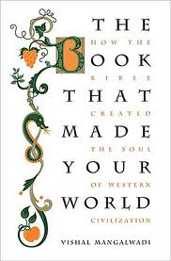
How come the whole world has come to accept what were strange and even “unrealistic”understandings of: economics, justice, human rights, heroism, optimism, compassion, family, morality?
Why does a U.S. President put his hand on the Bible to take an office that is secular?
What made even a King like Henry VIII submit to moral authority?
Ever heard of Martin Luther, Tyndale or Wycliffe – or considered that they might be history's greatest progressives?
Why and how did Europe become a historically unique civilization: technical and tolerant, scientific and free, prosperous and just ?
Notes:
The book has has been published in English, Spanish and Portuguese.
German is due in October.
Chinese, Greek and Italian are being negotiated; and it will certainly appear in Indonesian, Korean and possibly Japanese and Russian relatively soon.
Unfortunately, as people become rich, they also tend to become arrogant, and then to try to increase their power, if necessary by abandoning the morality and view of the world that brought them prosperity to begin with, thinking that they can maintain and perhaps even increase their prosperity if they do so.
Such abandonment of the Green Worldview by the arrogant rich in Europe led directly to the dominance of what I describe as the Red worldview. But we come to that after the next exercise.

Slide 38
At the most basic level, there are only five worldviews:
Black √
White √
Yellow √
Green √
Red
(The colours used are simply colours and do not signify anything beyond a help to memory)

Slide 39
RED
Now the dominant philosophy of the global elite, represented by the USA
Though many middle class people around the world are influenced by this too
Notes:
With the propaganda of the West’s elite from the 1880s focusing on Rationalism and Evolutionism, as well as from the 1960s, the propoganda about the work of Ayn Rand, the influence of the Bible was increasingly lost.
As a consequence, we moved into a phase where moral, human and environmental boundaries became increasingly marginal.
No wonder the result has been, for example, the global economic crisis that started in 2007 and has, in my view, not come to a resolution but merely been postponed.
What marks the Red philosophy or approach?

Slide 40
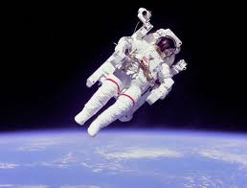
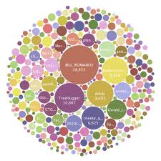
RED
Science & Technology will solve all problems
Notes:
First, the idea that technology will solve all problems
Do you believe that? If you do, you share at least one Red belief.
With respect, there are no such things as «side effects», there are only «effects» – and the tragedy is that we rush nowadays to commercialise technology before understanding the effects sufficiently.
We forget that each technological advance itself creates new challenges which are more complex!
And that every technological advance increases the gap betwen the technological haves and the technological have-nots.

Slide 41
RED
Society will look after itself if markets are left free
Notes:
The second Red belief is that society will look after itself if markets are left as free as possible.
Do you believe that?
If so, again, you share an essential Red belief.
However, I feel that, for most of us in this room, that view may be discredited - even though as a result of the wide discrediting of this view, we may now get markets that are improperly regulated and may simply be distorted in different ways than earlier.
What we need to have instead is the right sort of framework, which I have elsewhere described as fair, light, effective and humane.

Slide 42
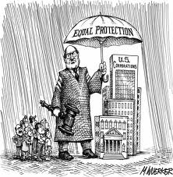
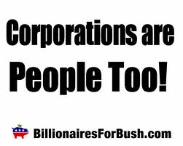
RED
Corporations should have the same rights as individuals, in addition to the privileges they already have as companies
Notes:
We don’t have time to discuss this right now, but you might want to take this up with me later.

Slide 43
RED
Morality and law are «necessary inconveniences» around which I should find as efficient a way as possible, while I focus on making as much money as I can, as quickly as I can, without thinking too much about the context or the consequences
Notes:
Finally, the belief that morality and law are «necessary inconveniences» around which I should find as efficient a way as possible, while I focus on making as much money as I can, as quickly as I can, without thinking too much about the context or the consequences.
This is of course what the red worldview is «really» about, driven as it is equally by greed and fear.
People who hold this belief preside over our largest institutions and make hypocritical statements about human and environmental responsibility in public conferences and forums and symposiums such as ours.
If you think I am exaggerating TO THE NOTES ON THE NEXT SLIDE

Slide 44
RED - summary
1. Nature and the environment are exploited rather than cared for
2. Production & distribution are controlled by a self-perpetuating elite
3. The wealthy & powerful are protected by the political, military & state system
4. Media is used to divert attention from social and civil issues to mere consumption
Notes:
Please understand that I have nothing against the particular institution that I am about to name but am simply using its name for convenience, and I could name similar things not only from almost any major bank but also from also any other major company in the world:
it is now public knowledge that Goldman Sachs acted against its clients’ interests as well as against the Government or public interest - and then lied about it (see the US Senate report), showing us clearly that that there is a whole layer of professionals that are leading our largest organisations and institutions to behave like thieves and pirates all over the world.
So here (above) is my summary of key beliefs that are held by Reds.

Slide 45
RED – summary (Contd.)
5. The ruling elite is, in effect, served by an underclass of consenting serfs
6. The industrial war machine forms a key aspect of economics & business
7. The dominant myth focuses on scarcity, continued growth & competition.

Slide 46
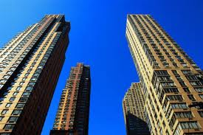
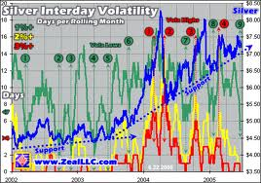
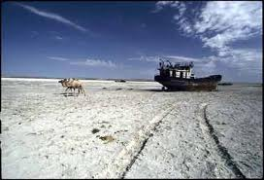
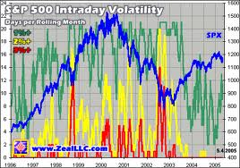
RED
Historically unprecedented global «progress»
But has created the largest number of poor people that the world has ever seen
The largest global gap between the poor and the rich
The greatest environmental impact
The most unstable and volatile monetary system
Notes:
What has been the result of the Red worldview? I have put «progress» in inverted commas because of the way progress is popularly defined nowadays.
For example, the way we calculate GDP, and our fixation with the rate of economic growth, don’t take into account the value of good relationships or good health or a good education or the feeling of freedom, or safety, or happiness.
Nor does it take into account that we have today the largest numbe of poor people at any one time in history.
Further, the Red view has created, through tax loopholes and tax giveaways, the largest gap ever seen in history between the rich and the poor, as well as the greatest environmental impact AND the most unstable and volatile monetary, financial and economic system ever seen in the history of the world.
For an alternative, see http://www.relationalthinking.org and http://www.relationshipsfoundation.org

Slide 47
Structure of my presentation
A. Some preliminary comments √
B. Reflections on our current global crisis √
C. What are some key features of our “Global System”? √
D. The 5 Paradigms for Viewing Systems & System-Change √
E. Some System-Change Initiatives
Notes:
You can get much more material on the content of this lecture, if you like, by looking for my articles and book chapters on the Internet.

Slide 48
Some System-Solutions
Fight the High Priests of Liquidity (demand Sound Money)
Discourage lending/ borrowing (encourage investment in the real economy)
Discourage High Frequency Trading (support a Financial Transaction Tax)
Fight the culture of Rights (encourage a culture of responsibility)
Fight the culture of Greed (nurture a culture of giving)
Fight the global culture of Fear (nurturing true optimism)
Fight the culture of Speed (encourage a culture of thoughtfulness)
Change Company Law to enable two classes of shares: Long Term & Short Term
Change Company Law to enable responsible behaviour (managements should not have to struggle against the demands created by current corporate law)

Slide 49
Some other key recommendations are in:

Slide 50
Structure of my presentation
A. Some preliminary comments √
B. Reflections on our current global crisis √
C. What are some key features of our “Global System”? √
D. The 5 Paradigms for Viewing Systems & System-Change √
E. Some System-Change Initiatives √
Notes:
You can get much more material on the content of this lecture, if you like, by looking for my articles and book chapters on the Internet.

